Slide 1

Chinook Music Store Analysis
Welcome to our comprehensive analysis of Chinook Music Services. This presentation examines sales data, market trends, and customer behavior to provide strategic insights for our global music distribution business.

Slide 2

About Chinook
Global Reach
Chinook operates a worldwide network of outlets, serving diverse musical tastes across continents.
Genre Diversity
Our catalog spans numerous genres, ensuring we cater to all musical preferences
Physical Records
We specialize in physical music formats, preserving the tangible aspect of music consumption.
Customer Focus
Our services are tailored to deliver an exceptional music discovery and purchasing experience.

Slide 3
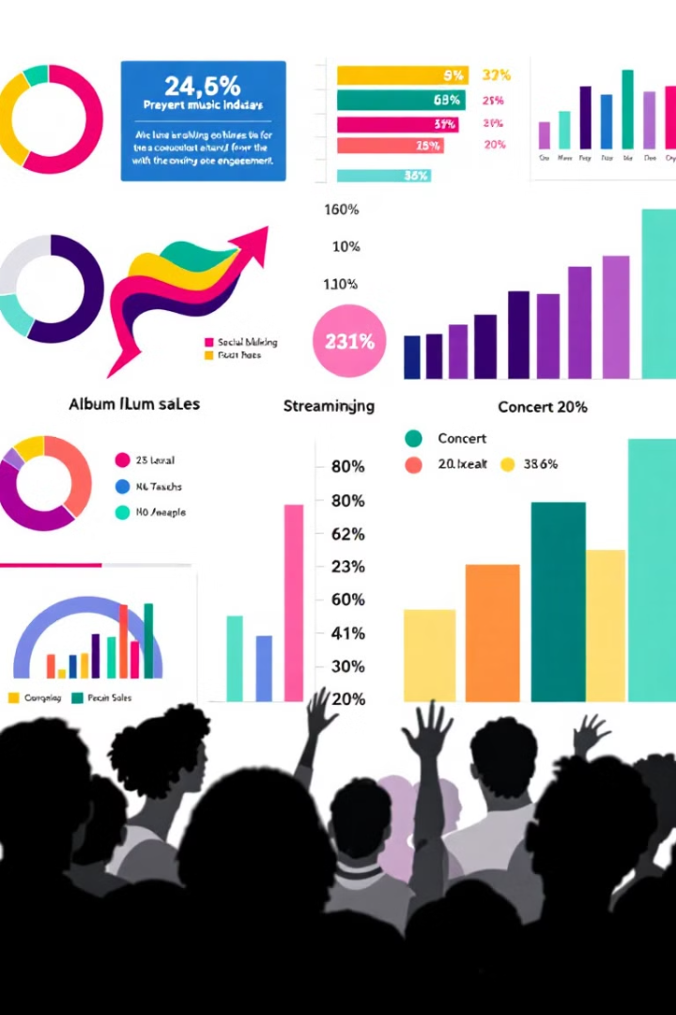
Problem Statement
We aim to dissect our sales data to uncover trends and opportunities in the physical music market.
Our goal is to leverage customer geographical data to inform targeted revenue growth strategies.

Slide 4

Data Overview
1
Comprehensive Dataset
11 tables provide a holistic view of Chinook's operations and market presence.
2
Global Reach
Customer base spans 24 countries, showcasing our international appeal.
3
Genre Diversity
25 music genres represented, from Rock to Jazz and beyond.
4
Detailed Records
Extensive information on tracks, albums, artists, and sales transactions.

Slide 5

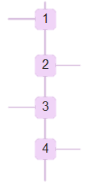
Data Collection
Gathered comprehensive sales and customer data from Chinook's global operations.
Data Cleaning
Processed and standardized data to ensure accuracy and consistency in analysis.
Analysis
Applied statistical methods to uncover patterns in customer behavior and sales trends.
Insight Generation
Interpreted results to formulate actionable business strategies and recommendations.

Slide 6
Customer Demographics
Key Takeaways: -
It shows that the customers are from 24 different countries.
The customer demographic breakdown is very diversified.
Maximum number of customers are from USA.

Slide 7
Genre Sales in USA
Rock dominates the US market with a commanding 35% share of sales
Alternative & Punk follows closely behind, contributing 15% to sales.
. Metal holds a strong third place with 12% of total sales.
Other genres, such as Jazz, Blues, and Classical, contribute to the remaining 38% of sales.

Slide 8




CHURN RATE
40.82%
Customer Churn Analysis
High Churn Rate
1
Customer retention is concerning, with significant
loss over time.
Retention Strategies
2
Implement promotional campaigns, music festivals,
and improved customer service.
Loyalty Programs
3
Develop targeted programs to
incentivize long-term customer relationships.

Slide 9
Album Promotion Recommendations for the USA
Recommendation Overview:
Based on genre sales analysis, the top 3 albums from the new record label for priority advertising and promotion in the USA are:
Every Kind of Light
20th Century Masters - The Millennium Collection: The Best of Scorpions
Speak of the Devil
Insight:
Genre Focus: All these albums belong to the Rock genre.
Reason: Rock is identified as the most popular genre in the USA based on sales data.

Slide 10
Top-Selling Genres: USA vs. Rest of the World
Commonality:
Rock genre dominates sales in both the USA and other countries.
Differences:
In the USA, Rock is followed by Pop and Jazz.
Globally (excluding the USA), Metal and Alternative & Punk secure the 2nd and 3rd positions, respectively.

Slide 11
Customer Purchasing Behavior
Long-term Customers
New Customers
Strategy
Higher frequency of purchases,
larger basket sizes, and greater
total spending.
Lower engagement across
all metrics, presenting
opportunities for targeted
retention strategies.
Focus on converting
new customers to
long-term patrons
to boost overall revenue.

Slide 12
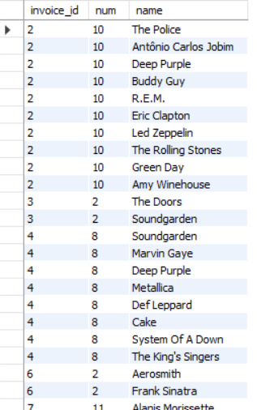
Product Affinity Analysis
Genres Frequently Purchased Together:
Rock, Metal, and Alternative & Punk are often purchased together.
Albums Frequently Purchased Together:
Mezmerize
The Doors
Dark Side of the Moon
Artists Frequently Purchased Together:
Green Day
Foo Fighters
U2
Recommendations:
Use these insights for cross-selling by
bundling related products.
Highlight popular combinations in marketing campaigns to drive more sales.

Slide 13
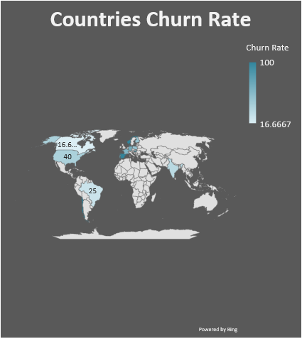
Regional Market Analysis:
Key Insights :
It is evident that the countries in Europe are having high churn rate.
It shows that economic factors play a crucial role in the sales of the company.
Therefore more number of advertisements should be launched in the countries with high economy and cheaper tracks should be sold in the coutries with low economy. Population of countries also affect the sales.

Slide 14
Customer Risk Profiling:
Key Insights:
Decreasing Trend: Sales dropped during the second-to-last quarter.
Recovery: Sales increased in the last quarter.
Action Plan:
Launch new promotional campaigns in countries with high churn rates.
Focus on maintaining and increasing customer spending.

Slide 15
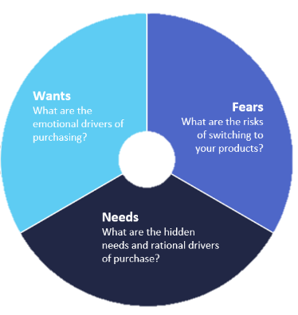
Customer Lifetime Value Analysis
High-Value Customers:
Identified by analyzing purchase history and tenure.
Focus on predicting lifetime value to prioritize loyal customers.
Potential Loyal Customers:
Customers with short tenure but high purchase history show potential.
Target with promotional campaigns to convert into loyal customers.
Impact of Economic Factors:
Customers from developing/underdeveloped countries exhibit lower purchase activity.
Boost sales through:
Social media campaigns
Advertisements and discounts

Slide 16
Recommendations :
Implement strategies to reduce churn rates in key markets.
Expand services to additional countries to grow the customer base
Focus on customer retention to boost revenue growth
Prioritize the USA market with targeted promotional campaigns.

Slide 17

Recommendations :
The sales over month trend should be maintained and increasing month over month
Using personal recommendations for each and every customer.
E-mail marketing techniques should be used to inform customers about new discounts and sales.

Slide 18

"Music is the universal language that speaks to the soul, igniting emotions, inspiring creativity, and connecting hearts across the world."

Slide 19

Counclusion
Key Trends: Patterns were observed across countries, genres, and artists, providing valuable insights into market behavior.
Strategic Needs: To drive growth, the company must invest in stronger promotion, targeted marketing, and expanding its market reach.
Customer Retention: Retaining existing customers is essential to boosting revenue and sustaining long-term success.
Performance Insights: Key metrics analyzed include:
Customer purchase frequency.
Average basket size per customer.
Spending habits of customers.

Slide 20
References :
www.wikipedia.com
www.github.com
www.kaggle.com
www.analyticsvidya.com

Slide 21
Thank you

